Slide 1






Home
UFCD-5124
Contact
Kenay
ONLINE
INTERACTION
Learn More
Start Now

Slide 2

SEARCH ENGINES

Slide 3





Search
Engines
A program that searches for and identifies items in a database that correspond to keywords or characters specified by the user, used especially for finding particular sites on the World Wide Web.
Read More. . .

Slide 4


Google Chrome
“Our mission is to organize the world’s information and make it universally accessible and useful.”
— Google
Examples:
Search Engines
Brave
“Brave is…so aggressive about blocking trackers that in the process, it almost always blocks ads entirely. . .”
— New York Times

Slide 5
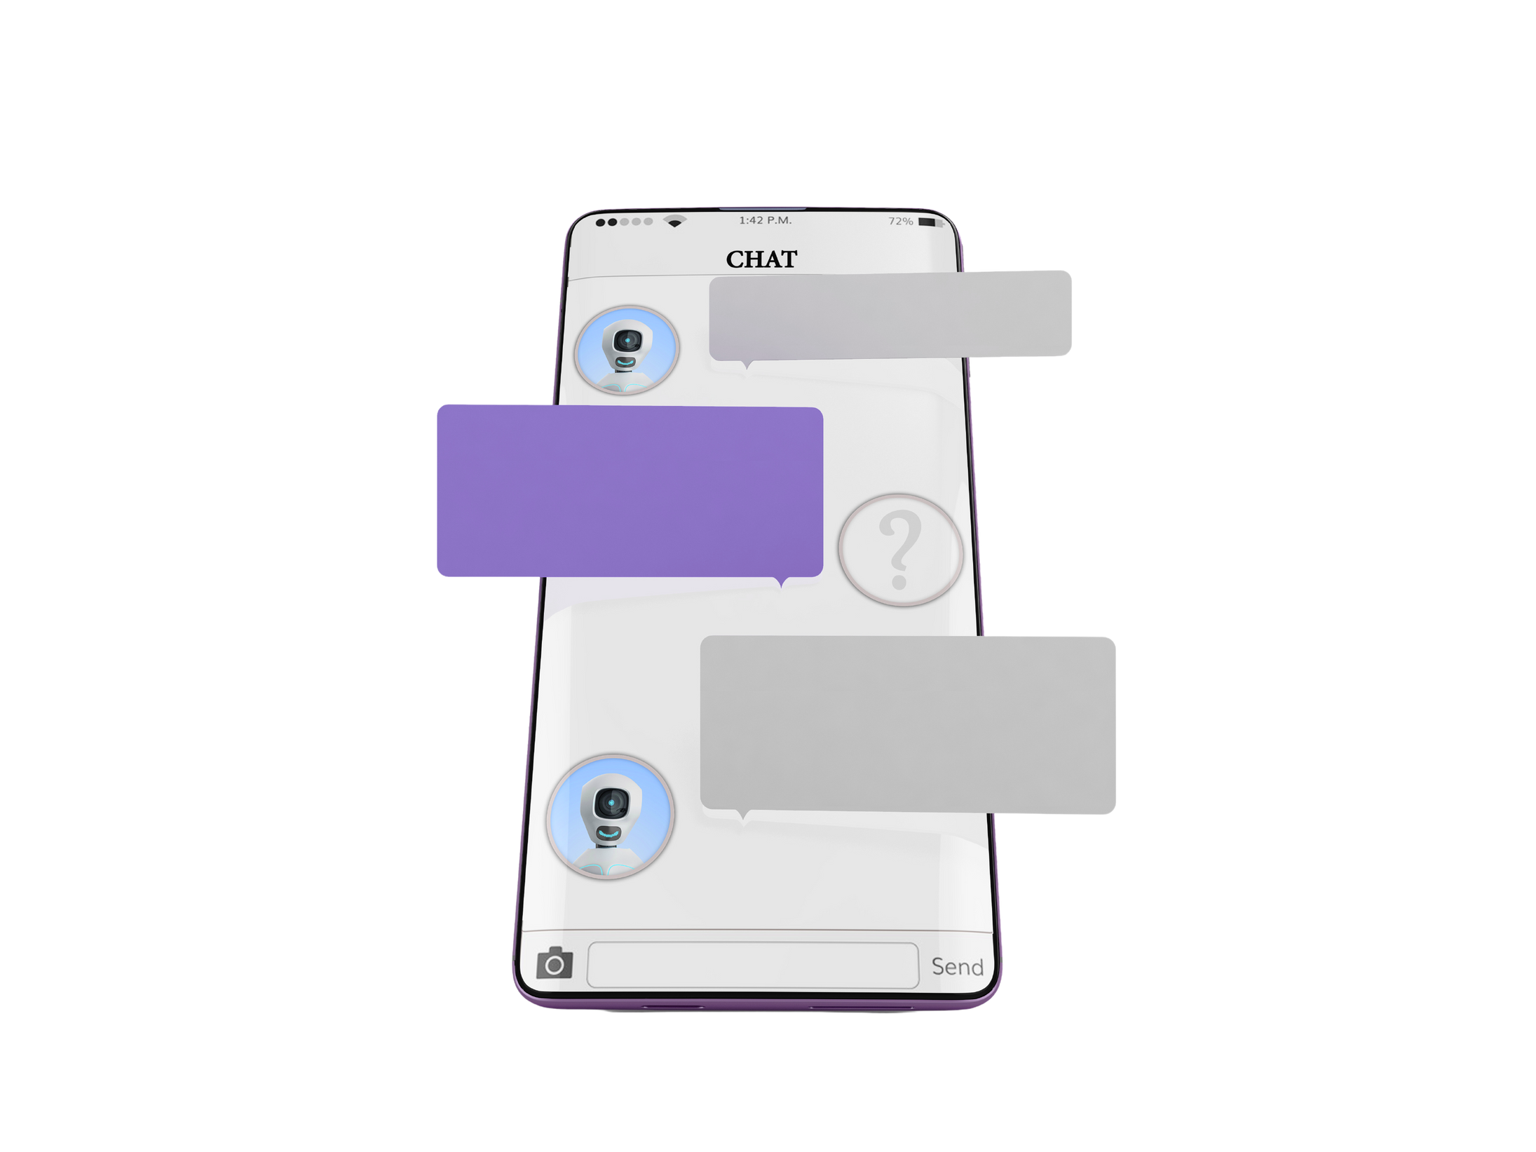

Chat
Rooms
An area on the internet or other computer network where users can communicate, typically one dedicated to a particular topic.

Slide 6




Examples
Chat Rooms
Skype
Discord
Microsoft Teams
“Is software that enables the world's conversations”
“Is a voice, video and text communication service used by over a hundred million people to hang out and talk with their friends and communities.”
“A workspace for real-time collaboration and communication, meetings, file and more... All accessible to everyone.”

Slide 7


Video
Conferencing
Video conferencing is live, visual connection between two or more remote parties over the internet that simulates a face-to-face meeting.

Slide 8

Examples
Video Conferencing
Discord
Skype
“Is a voice, video and text communication service used by over a hundred million people to hang out and talk with their friends and communities.”
“Is software that enables the world's conversations”

Slide 9



THANK
YOU

